Slide 1

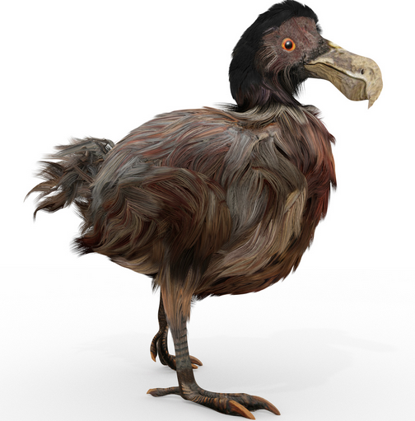


Экология и эволюция
Игорь Мартынович Рузин
Доцент, в.н.с.
ivan4995@gmail.com
igor.rouzine@iephb.ru
Notes:
Je vais vous raconter l'histoire de la sélection naturelle, qui est responsable de toute la diversité de la vie sur la planète.

Slide 2
Приложение к ВИЧ
Высокая скорость эволюции в нелеченых
Эволюционная роль латентности ВИЧ

Slide 3
High rate of evolution in untreated patients
How to develop a model

Slide 4
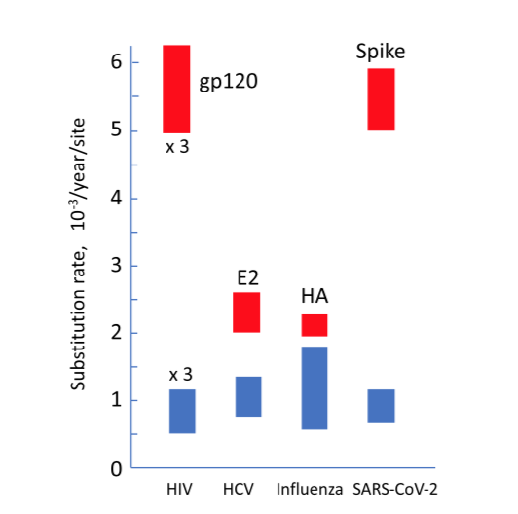
Why is the substitution rate so high?

Slide 5
How to develop a useful model
Data 1
Question
Equations
Model
Read the literature, guess the most important factors
Make plausible assumptions and simplifications
Chose a suitable mathematical technique. Write the equations
Solve them numerically or analytically
Compare the results with new experiments
If a prediction is wrong, go back to Step 1.
Disagreement
Prediction
Data 2
Agreement
Article

Slide 6
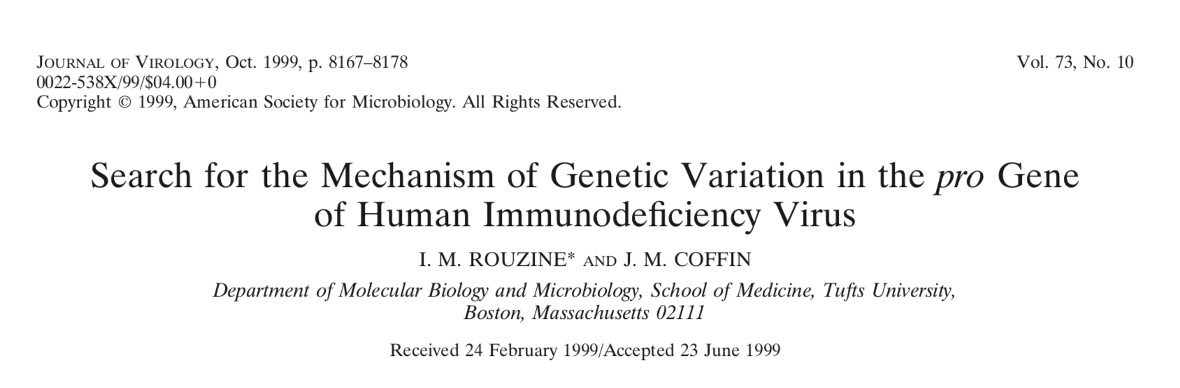
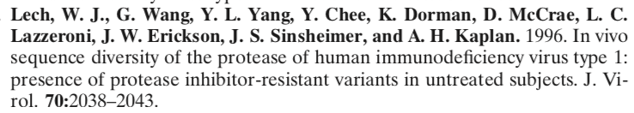
Where does the high heterozygocity of HIV come from?
Models
Data
Notes:
To obtain a more detailed picture of genetic variation in pro, we analyzed the database of se- quences described by Lech et al. (22). Sequences were ob- tained at a single time point from protease-inhibitor-naive patients. The 265 clones of proviral DNA were derived from peripheral blood mononuclear cells of 13 individuals by 70 cycles of nested PCR amplification, and the consensus se- quence for each patient’s virus was obtained. Of the 13 pa- tients, two (06 and 12) had stop codons in their consensus sequences and were excluded from further analysis. For the remaining 11 patients, 6% of the sequences contained dele- tions, insertions, or stop codons; these sequences were also filtered out, since the present work addresses point mutations, which do not render the virus nonviable. The remaining data- base comprised 213 clones of proviral DNA. We determined the common consensus sequence by noting the most frequent variant for each base. The consensus sequence starts from the conserved sequence CCTCAgATCACTCTT (PQITL), where g shows a variable base, and is 297 bases long. It is identical to the subtype B consensus in the LANL database (19a). Of the total number of substitutions, 25% were transversions with respect to the consensus sequence. To simplify further analysis, we ignored transversions, replacing them by the consensus sequence. As a result, each base was represented by two ge- netic variants: either A/G or C/T. (A theory taking into con- sideration both types of mutation would have to contain more parameters, namely, the forward and reverse mutation rates for transversions, which are very low and known with poor accuracy. This would complicate the theory without much gain in information.) Finally, to partially correct for errors accumlated during PCR, we ignored mutations present in a single copy in the entire database.

Slide 7
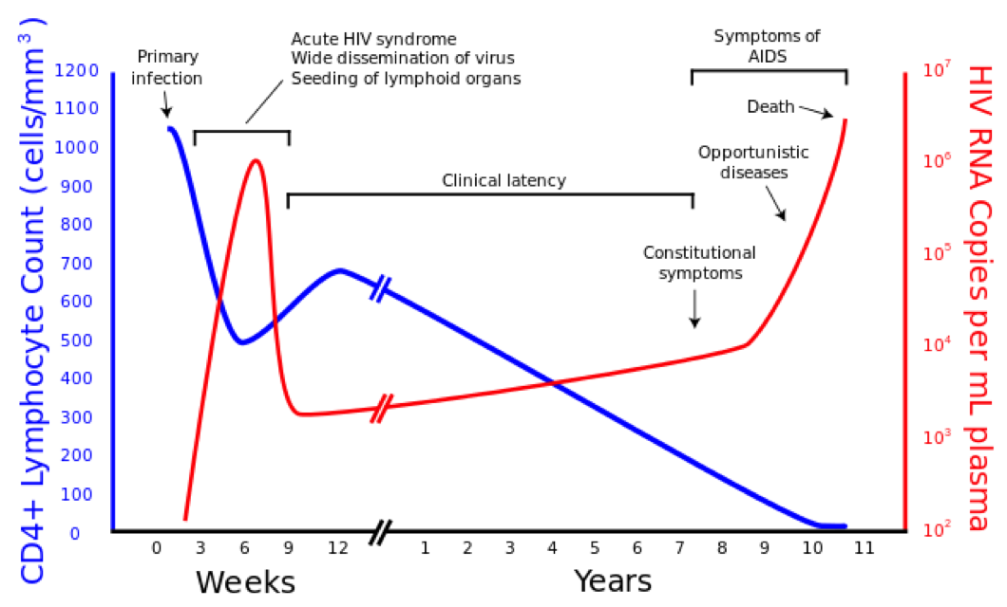
HIV dynamics in the absence of treatment
Quasi-stationary state

Slide 8
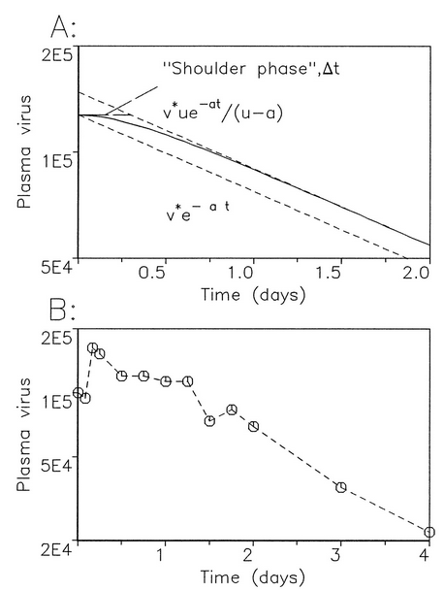
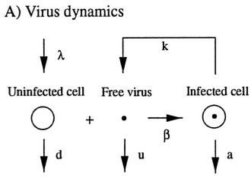
Rapid virus rotation
infected cell lives 1 day (Ho et all 1995)
Bonhoeffer, May, Shaw, and Nowak, 1997

Slide 9
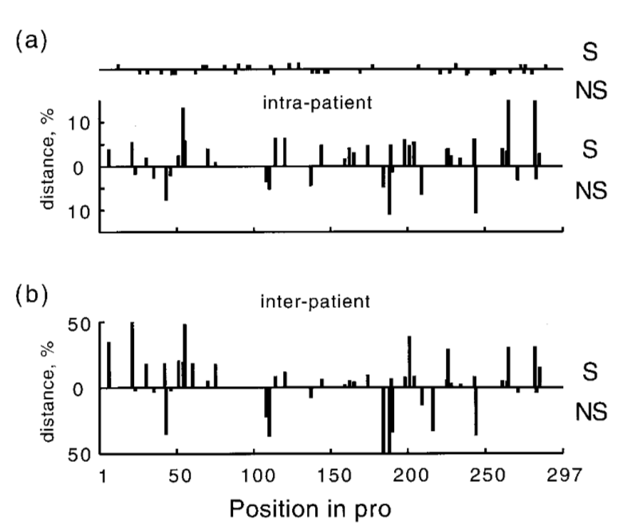
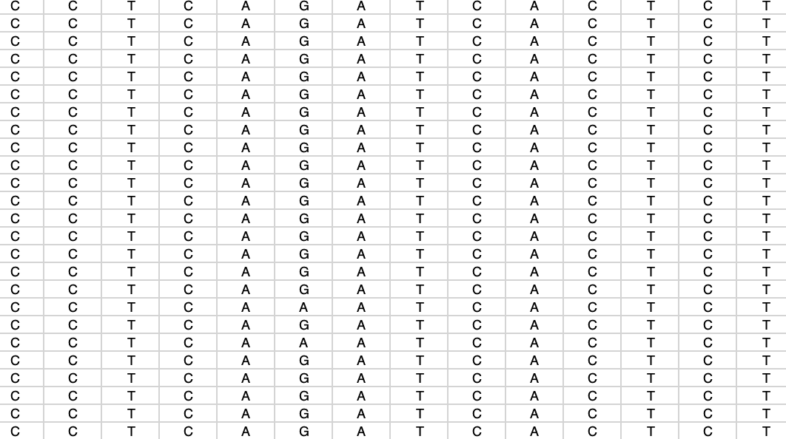
Heterozygocity (gen. distance, polymorphism, diversity) intra- and inter-patient
Т = 2 f(1-f)
Different isolates
Protease gene loci
Т₁₂ = 2 f₁(1-f₂)
Notes:
Intrapatient (a) and interpatient (b) genetic distances, averaged over patients, at different positions in pro. The upper and lower histograms in each figure correspond to synonymous and nonsynonymous sites, respectively. Dots on the upper horizontal line in panel a show the positions of sporadic mutations (seen only once in the data set).

Slide 10
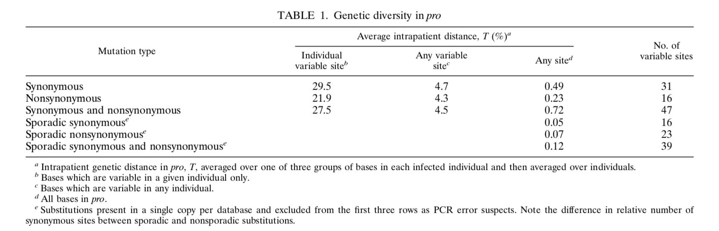
Genetic diversity within patients
47 variable nt out of 297nt total
Total virus 10,000 nt, variable > 1500 nt

Slide 11
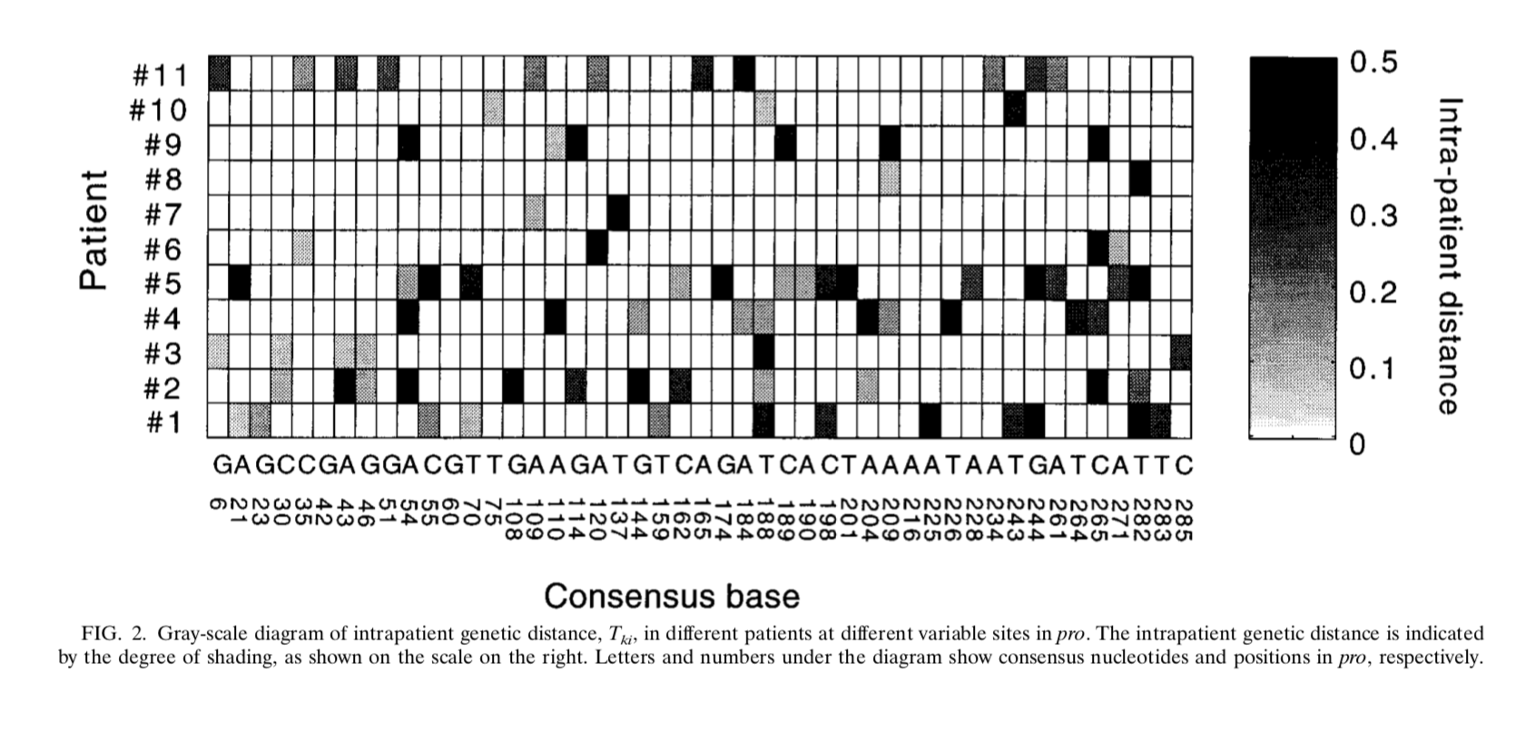
Genetic diversity (distance, heterozygocity) within patients
Т = 2 f(1-f)
Notes:
Gray-scale diagram of intrapatient genetic distance, Tki, in different patients at different variable sites in pro. The intrapatient genetic distance is indicated by the degree of shading, as shown on the scale on the right. Letters and numbers under the diagram show consensus nucleotides and positions in pro, respectively.

Slide 12
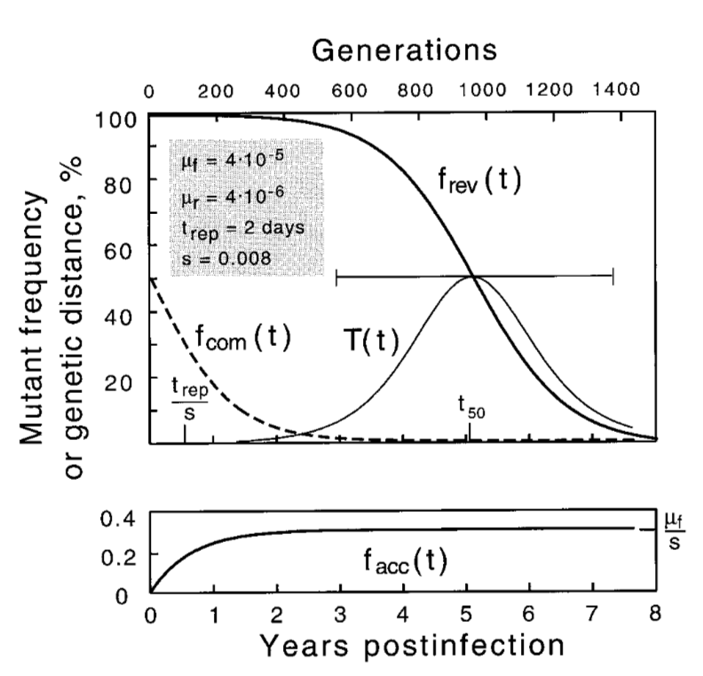
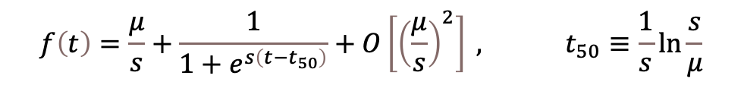
Mutant reversion within a patient explains high polymorhism
Assumption: a patient receives a mutant locus
Т = 2 f(1-f)
Mutation rate μ = 10⁻⁵
Cell rotation rate = ½ день,
Average sample time = 5 years
Fitting: s=0.008
$$f\left(t\right)=\frac{μ}{s}+\frac{1}{1+e^{s\left(t−t_{50}\right)}}+O\left[{\left(\frac{μ}{s}\right)}^{2}\right] , t_{50}≡\frac{1}{s}ln\frac{s}{μ}$$
Notes:
Time dependence of the mutant frequency at different initial popu- lations: purely mutant (reversion) (thicker line in upper panel), purely wild type (accumulation) (lower panel), or 50% mutant (growth competition) (dashed line). The thinner curve shows the intrapatient genetic distance T(t) during reversion. The horizontal bar is the time interval during which the base would be classified as variable (5 to 95%). Values shown in the upper left corner corre- spond to parameters as follows: the forward (wild type 3 mutant) and reverse mutation rates, 􏰐f and 􏰐r, corresponding to either A or C wild type; the repli- cation cycle time, trep; and selection coefficient, s. The reversion half-time, t50, is given by the equation t50 􏰇 (trep/s)ln(s/􏰐r).

Slide 13
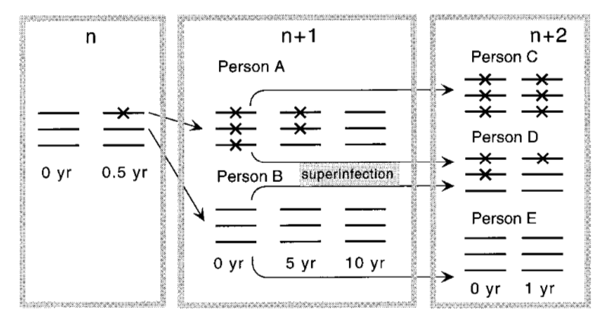
Why are there so many polymorphous loci?
Stochastic bottleneck: one virus DNA transferred
Notes:
Model of evolution of a nucleotide along the chain of infected individuals under purifying selection. The numbers at the top denote cycles of transmission. X signs denote mutants. A mutant base appears spontaneously in person n, who infects person A with the mutant and person B with the wild-type variant. Person A passes the mutant down the chain to person C, after which his/her own virus population slowly reverts to the wild type. In person D, who is stably coinfected with a pair of sequences polymorphous at that base, selection clears the mutant virus rapidly.

Slide 14
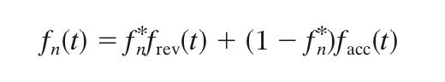
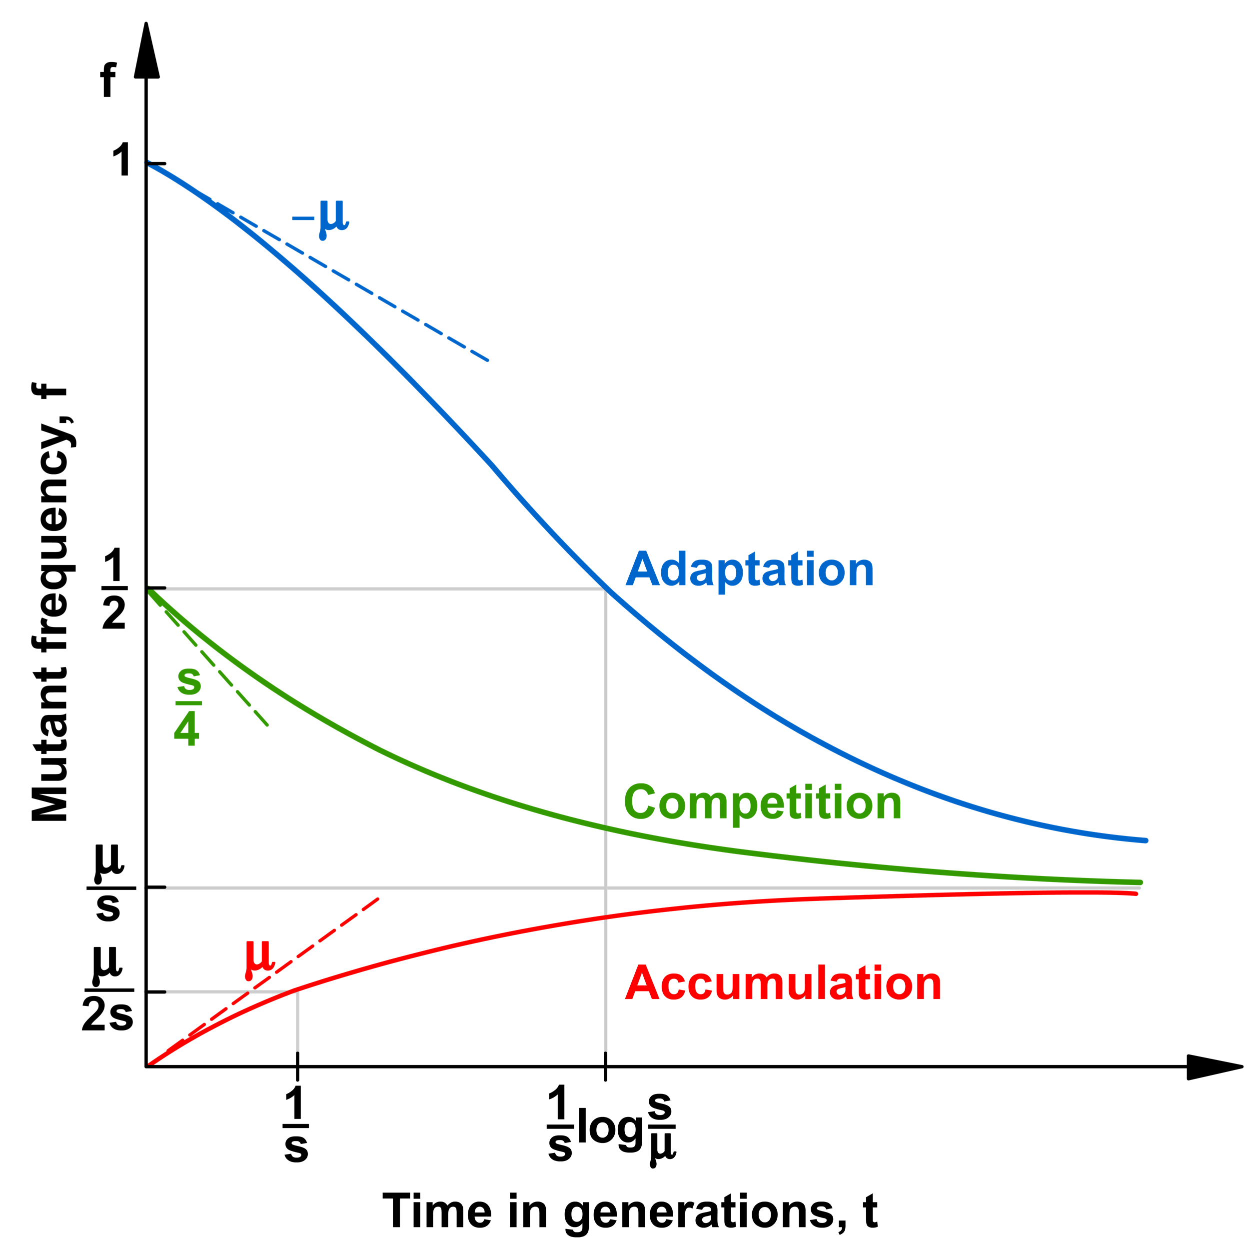
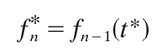
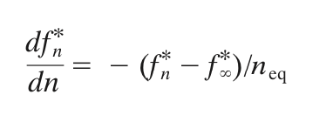
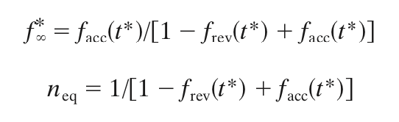
Markov chain of transmission Assumption: t* << (1/s)log(s/μ)
Probability of receiving mutant allele
time of transmission t*
time of transmission t*
Notes:
Time dependence of the mutant frequency at different initial populations: purely mutant (reversion) (thicker line in upper panel), purely wild type (accumulation) (lower panel), or 50% mutant (growth competition) (dashed line). The thinner curve shows the intrapatient genetic distance T(t) during reversion. The horizontal bar is the time interval during which the base would be classified as variable (5 to 95%). Values shown in the upper left corner correspond to parameters as follows: the forward (wild type 3 mutant) and reverse mutation rates, 􏰐f and 􏰐r, corresponding to either A or C wild type; the replication cycle time, trep; and selection coefficient, s. The reversion half-time, t50, is given by the equation t50 􏰇 (trep/s)ln(s/􏰐r).

Slide 15
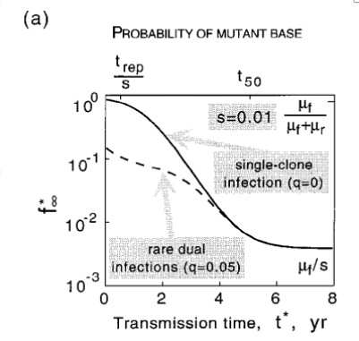
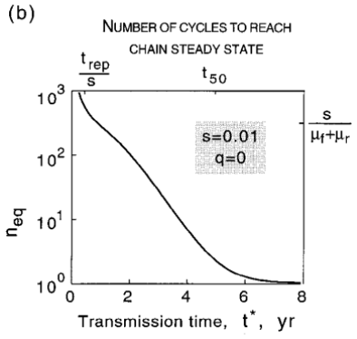
The model predict high frequency of polymorphous sites in the long term
Freuency of polymorphous sites
Notes:
Time dependence of the mutant frequency at different initial populations: purely mutant (reversion) (thicker line in upper panel), purely wild type (accumulation) (lower panel), or 50% mutant (growth competition) (dashed line). The thinner curve shows the intrapatient genetic distance T(t) during reversion. The horizontal bar is the time interval during which the base would be classified as variable (5 to 95%). Values shown in the upper left corner correspond to parameters as follows: the forward (wild type 3 mutant) and reverse mutation rates, 􏰐f and 􏰐r, corresponding to either A or C wild type; the replication cycle time, trep; and selection coefficient, s. The reversion half-time, t50, is given by the equation t50 􏰇 (trep/s)ln(s/􏰐r).

Slide 16
Model 2: Co-infection from two sources
Notes:
Time dependence of the mutant frequency at different initial popu- lations: purely mutant (reversion) (thicker line in upper panel), purely wild type (accumulation) (lower panel), or 50% mutant (growth competition) (dashed line). The thinner curve shows the intrapatient genetic distance T(t) during reversion. The horizontal bar is the time interval during which the base would be classified as variable (5 to 95%). Values shown in the upper left corner corre- spond to parameters as follows: the forward (wild type 3 mutant) and reverse mutation rates, 􏰐f and 􏰐r, corresponding to either A or C wild type; the repli- cation cycle time, trep; and selection coefficient, s. The reversion half-time, t50, is given by the equation t50 􏰇 (trep/s)ln(s/􏰐r).

Slide 17
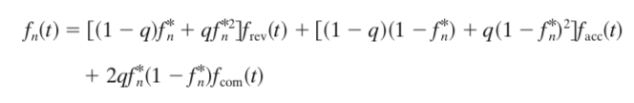
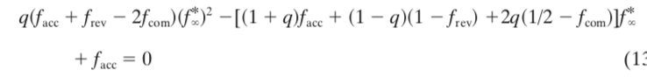
Model 2: Superinfection from two sources
q probability of superinfection

Slide 18
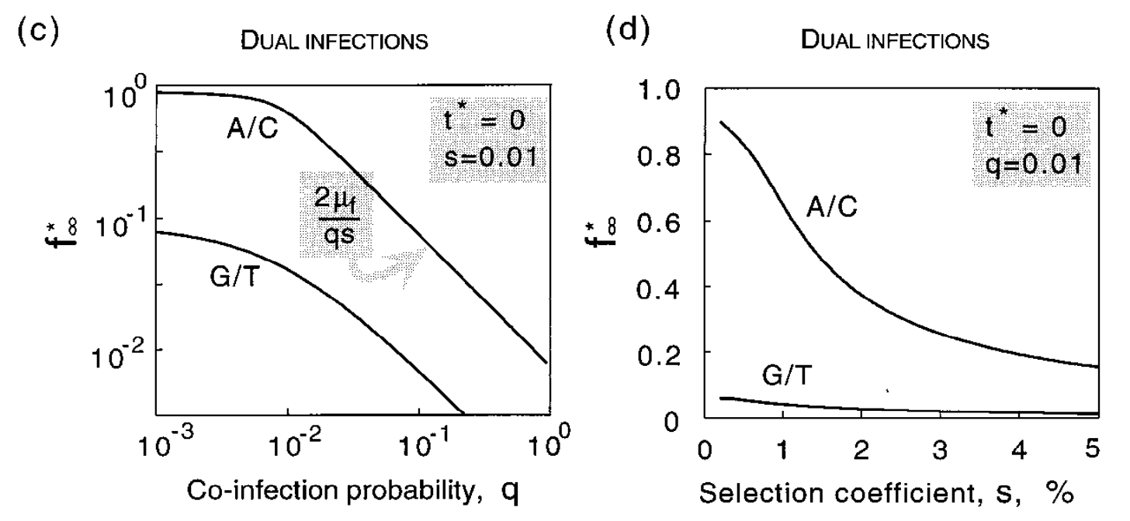
Rare superinfections kill mutants

Slide 19
Conclusion 1
High polymorphism at a site can be explained by reversion of mutant alleles (virus adaptation to host)
Without co-infection, the bottleneck of transmission turns off selection and favors accumulation of mutant alleles along the transmission chain
10% of superinfection is enough to suppress it due to competition between mutant and wild type inoculum
Where do so many polymorphous sites come from?
Notes:
A working model of evolution in pro. A quick initial switch of dom- inant epitopes redefines wild type for a number of sites, which then revert to this new wild type at speeds inversely proportional to their selection coefficients. (a) Time dependence of mutant frequency at three sites linked to an epitope. The three selection coefficients after the epitope switch are shown near correspond- ing curves. (b) Evolution of an individual consensus sequence at the three sites. pt, patient.

Slide 20
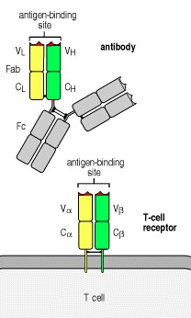
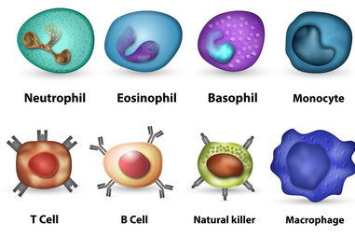
How T cell response works
Immune cells
Two receptor types

Slide 21
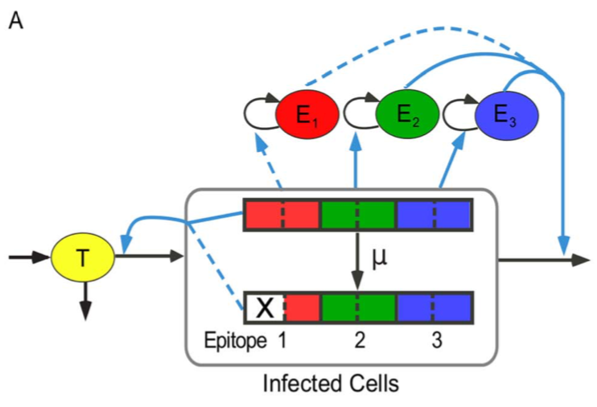
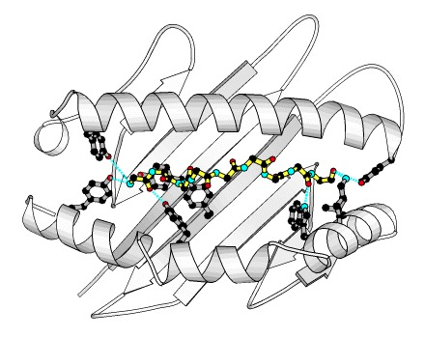
Модель 2.0: побег от иммунного отклика
MHC-I и пептид вируса

Slide 22
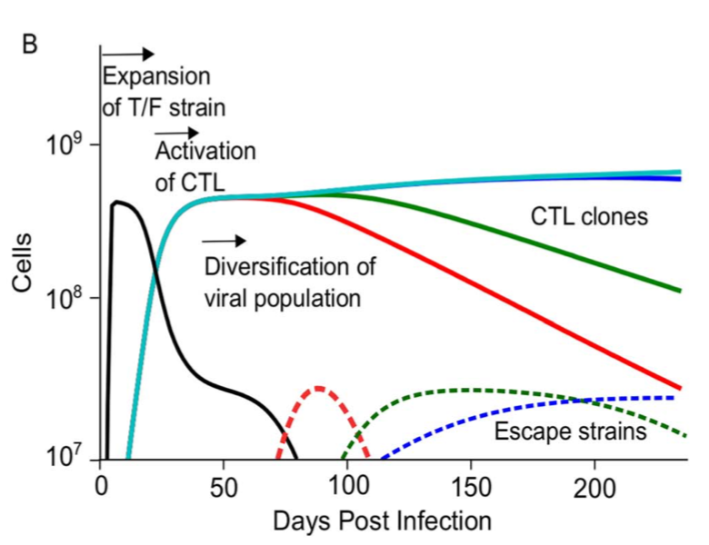
How do you observe it
Notes:
A working model of evolution in pro. A quick initial switch of dom- inant epitopes redefines wild type for a number of sites, which then revert to this new wild type at speeds inversely proportional to their selection coefficients. (a) Time dependence of mutant frequency at three sites linked to an epitope. The three selection coefficients after the epitope switch are shown near correspond- ing curves. (b) Evolution of an individual consensus sequence at the three sites. pt, patient.

Slide 23
Comparison with experiment fails
We can explain mutant alleles by escape in epitopes
25-30 active CD8 T cell epitopes
There are more than 1000 heterozygous loci
What about the difference?
Notes:
A working model of evolution in pro. A quick initial switch of dom- inant epitopes redefines wild type for a number of sites, which then revert to this new wild type at speeds inversely proportional to their selection coefficients. (a) Time dependence of mutant frequency at three sites linked to an epitope. The three selection coefficients after the epitope switch are shown near correspond- ing curves. (b) Evolution of an individual consensus sequence at the three sites. pt, patient.

Slide 24
Including epistasis

Slide 25
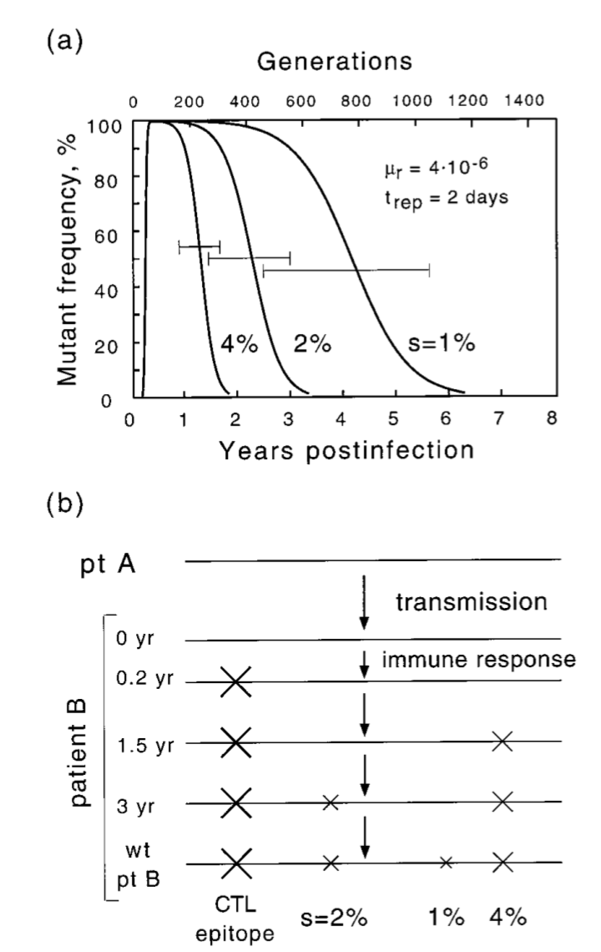
Escape from the immune response and the cascade of compensating mutations
Sign of s has changed
large E
small E
Notes:
A working model of evolution in pro. A quick initial switch of dom- inant epitopes redefines wild type for a number of sites, which then revert to this new wild type at speeds inversely proportional to their selection coefficients. (a) Time dependence of mutant frequency at three sites linked to an epitope. The three selection coefficients after the epitope switch are shown near correspond- ing curves. (b) Evolution of an individual consensus sequence at the three sites. pt, patient.

Slide 26
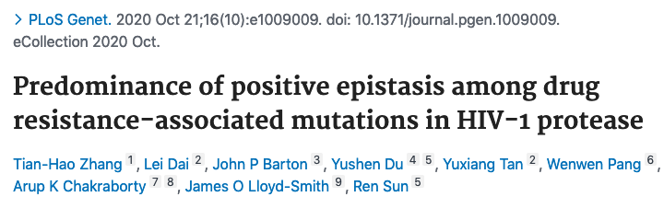
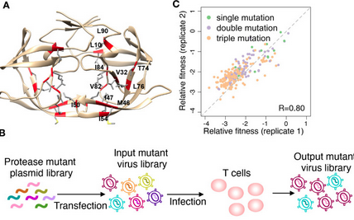
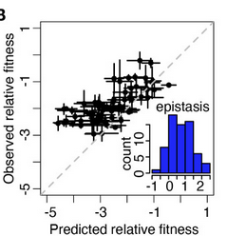
11 years later...
Notes:
A working model of evolution in pro. A quick initial switch of dom- inant epitopes redefines wild type for a number of sites, which then revert to this new wild type at speeds inversely proportional to their selection coefficients. (a) Time dependence of mutant frequency at three sites linked to an epitope. The three selection coefficients after the epitope switch are shown near correspond- ing curves. (b) Evolution of an individual consensus sequence at the three sites. pt, patient.

Slide 27
Conclusions II
High heterozygocity of HIV in patients is due to virus adaptation (reversion of mutants)
Primary mutations are due to antigenic escapes in epitopes
Secondary sites are due to epistasis,the compensation of primary sites
Notes:
A working model of evolution in pro. A quick initial switch of dom- inant epitopes redefines wild type for a number of sites, which then revert to this new wild type at speeds inversely proportional to their selection coefficients. (a) Time dependence of mutant frequency at three sites linked to an epitope. The three selection coefficients after the epitope switch are shown near correspond- ing curves. (b) Evolution of an individual consensus sequence at the three sites. pt, patient.

Slide 28
What is the benefit of latency to HIV?
Аdditional material. Use if > 20 minutes are left
In natural population history (chimpanzee), latency holds no obvious benefit to HIV (there is no ART)
Dominant view: Latency is an evolutionary accident
Coffin & Swanstrom 2013
Eisele & Siliciano 2012

Slide 29

Bi-stability is “hardwired” into HIV gene regulation
Cell factors (present in activated cells) initiate mRNA transcription
and HIV protein production
NFkB
Viral factor Tat accelerates
and stabilizes transcription
New hypothesis: latency is an evolved trait in natural population
Razooky, Pai, Aull, Rouzine, Weinberger L. 2015, Cell 160, 990–1001

Slide 30
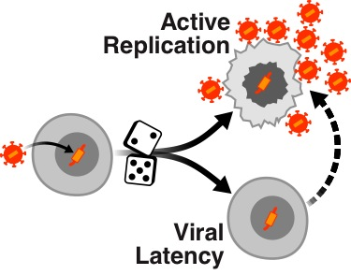
Evolved HIV roulette: ON or OFF
Probability 1- p
Activation rate/day r
Probability p
p and r may depend on:
initial cell cycle phase AND exogenous cytokines
Weinberger L., Cell 2005

Slide 31
Facts of mucosal infection
Haase’s group
Miller et al 2005
SIV in monkeys: Virus is not present/does not replicate at mucosal entry at day 2 to 5 post infection
R₀ (Number of newly infected cells per old cell) < 1
Reason: Poor supply of target CD4 T cells during the first ~5 days
Day 6+: More target cells cells are recruited, R_{0muc} > 1 (systemic expansion starts)

Slide 32
Hypothesis: Latent cells are “Trojan horse” of HIV
Rouzine, Weinberger A & Weinberger L, Cell 2015

Slide 33
Two-compartment model

Slide 34
Basic model of virus replication (for both mucosa and lymphoid tissue)
Replication numbers: R_{0muc} = b_{muc}kn/cd_{I} , R_{0sys} = b_{sys}kn/cd_{I}
Mucosa: R_{0muc} < 1. Systemic: R_{0sys} > 1.

Slide 35
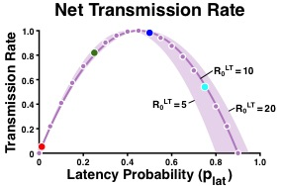
Optimal latency probability balances viral dose and transfer to LT
Culture data:
Eric Verdin’s group:
p_{lat}=0.1-0.4 in culture
p_{lat} [(1- p_{lat})R₀^{LT} - 1]

Slide 36
Why p_{lat} = 10⁻³ - 10⁻⁵ in chronic patients?
New question creates an upgrade of the model

Slide 37
CD8 T and CD4 T cells secrete activating cytokines
TNF-alpha
IL-2
p(E) = p(0)E_{0L}/(E_{0L}+E)
r (E) = r(0) + d_{I} E/(E_{0L}+E)

Slide 38
Activation by immune cells causes a sharp drop in latency
Data points:
Fraser et al 2007
Chun et al 1997
Finzi et al 1997
Turnbull et al 2009
p(E) = p(0)E_{0L}/(E_{0L}+E)
r (E) = r(0) + d_{I} E/(E_{0L}+E)
Days Post-transmission

Slide 39
Conclusions III
A high probability of HIV latency at the entry, p_{lat}, is to optimize viral transmission
The low levels of HIV latency in chronic infection is due to exogenous CD4 cell activation at ~ 2 to 3wk p.i.
Limitation: this model does not take into account proviruses that cannot be activated
Does not explain long-range latencty

Slide 40
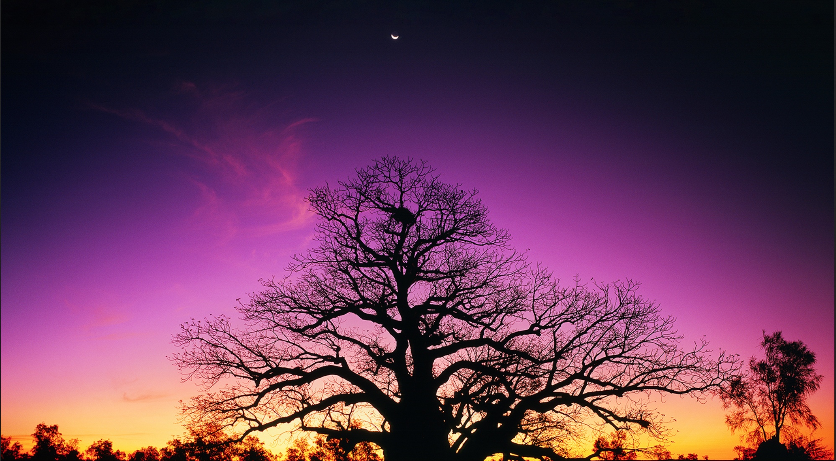
Теория, мой друг, суха́, но зеленеет жизни древо
Grau, teurer Freund, ist alle Theorie und grün des Lebens goldner Baum
Mon cher ami, toute theorie est grise,
Et l’Arbre de vie est vert toujours
My dearest friend, all theory is grey
And Tree of Life is evergreen
Johann Wolfgang von Goethe

